Slide 1
TCP/IP ARCHITECTURE

Slide 2
TCP/IP Protocol Architecture
Developed by the US Defense Advanced Research Project Agency (DARPA) for its packet switched network (ARPANET)
Used by the global Internet
No official model but a working one.
  Application layer
  Host to host or transport layer
  Internet layer
  Network access layer
  Physical layer

Slide 3
Introduction to TCP/IP
The Internet Protocol Suite (commonly known as TCP/IP) is the set of communications protocols used for the Internet and other similar networks.
It is named from two of the most important protocols in it:
  Transmission Control Protocol (TCP) and
  Internet Protocol (IP), which were the first two networking protocols defined in this standard.

Slide 4
TCP/IP Layers
OSI | TCP/IP
Application Layer | Application Layer TELNET, FTP, SMTP, POP3, SNMP, NNTP, DNS,NIS, NFS, HTTP, ...
Presentation Layer
Session Layer
Transport Layer | Transport Layer TCP , UDP , ...
Network Layer | Internet Layer IP , ICMP, ARP, RARP, ...
Data Link Layer | Link Layer FDDI, Ethernet, ISDN, X.25,...
Physical Layer

Slide 5
Physical Layer
Physical interface between data transmission device (e.g. computer) and transmission medium or network
Characteristics of transmission medium
Signal levels
Data rates
etc.

Slide 6
Network Access Layer
Exchange of data between end system and network
Destination address provision
Invoking services like priority

Slide 7
Internet Layer (IP)
Systems may be attached to different networks
Routing functions across multiple networks
Implemented in end systems and routers

Slide 8
Transport Layer (TCP)
Reliable delivery of data
Ordering of delivery

Slide 9
Application Layer
Support for user applications
e.g. http, SMPT

Slide 10
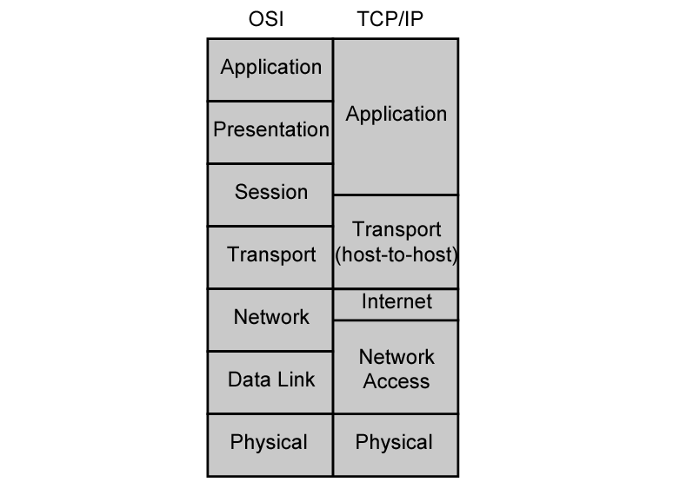
OSI v TCP/IP

Slide 11
TCP
Usual transport layer is Transmission Control Protocol
  Reliable connection
Connection
  Temporary logical association between entities in different systems
TCP PDU
  Called TCP segment
  Includes source and destination port (c.f. SAP)
    Identify respective users (applications)
    Connection refers to pair of ports
TCP tracks segments between entities on each connection

Slide 12
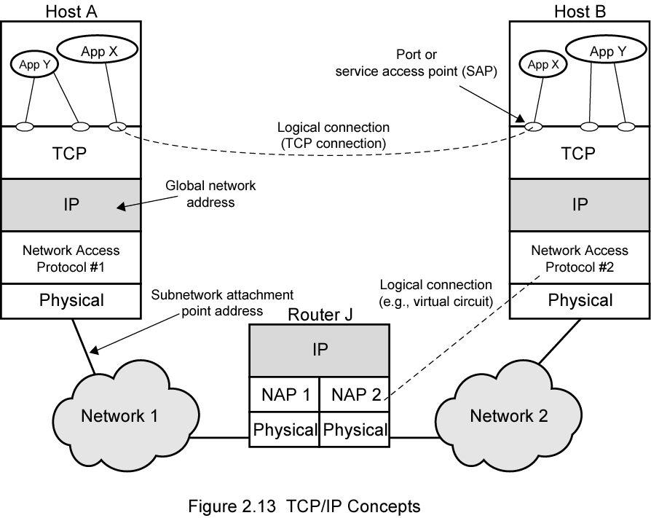
TCP/IP Concepts

Slide 13
Addressing level
Level in architecture at which entity is named
Unique address for each end system (computer) and router
Network level address
  IP or internet address (TCP/IP)
  Network service access point or NSAP (OSI)
Process within the system
  Port number (TCP/IP)
  Service access point or SAP (OSI)

Slide 14
Trace of Simple Operation
Process associated with port 1 in host A sends message to port 2 in host B
Process at A hands down message to TCP to send to port 2
TCP hands down to IP to send to host B
IP hands down to network layer (e.g. Ethernet) to send to router J
Generates a set of encapsulated PDUs

Slide 15
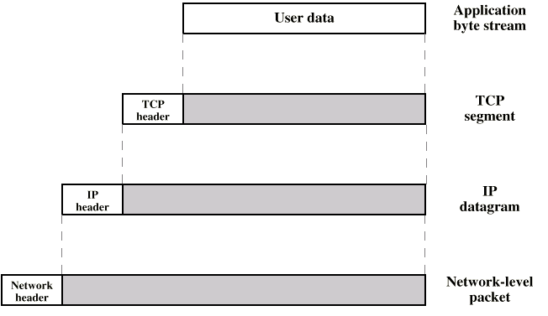
PDUs in TCP/IP

Slide 16
Example Header Information
Destination port
Sequence number
Checksum

Slide 17
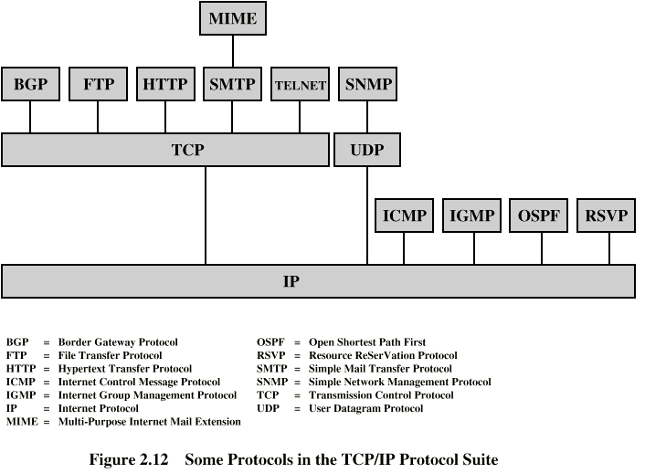
Some Protocols in TCP/IP Suite

Slide 18
TCP/IP Some Protocol
Layer | Protocol
Application | DNS, TFTP, TLS/SSL, FTP, Gopher, HTTP, IMAP, IRC, NNTP, POP3, SIP, SMTP, SMPP, SNMP, SSH, Telnet, Echo, RTP, PNRP, rlogin, ENRP
 | Routing protocols like BGP and RIP which run over TCP/UDP, may also be considered part of the Internet Layer.
Transport | TCP, UDP, DCCP, SCTP, IL, RUDP, RSVP
Internet | IP (IPv4, IPv6), ICMP, IGMP, and ICMPv6
 | OSPF for IPv4 was initially considered IP layer protocol since it runs per IP-subnet, but has been placed on the Link since RFC 2740.
Link | ARP, RARP, OSPF (IPv4/IPv6), IS-IS, NDP

